Slide 1
Basic statistics
Mahipal Singh

Slide 2
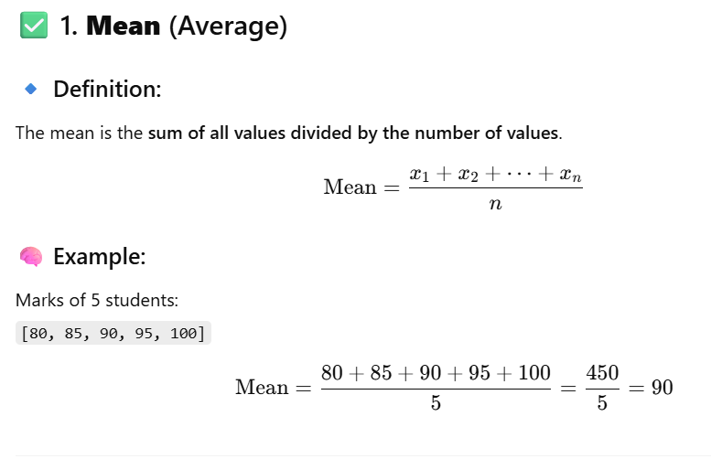

Slide 3
When Mean is NOT good
When data has outliers (extreme values).
Example: [80, 85, 90, 95, 1000] Mean becomes 268, which does not represent the group well.

Slide 4
How to handle outliers
Median is better approach

Slide 5
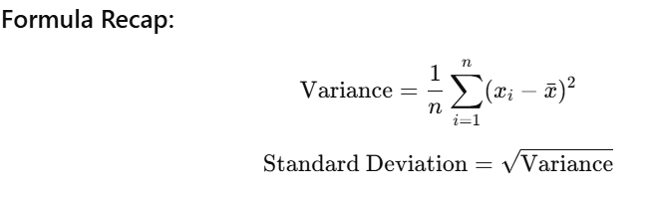

Slide 6
Variance tells us how spread out the data is around the mean.
Standard deviation: on average, how far is a value from the mean

Slide 7
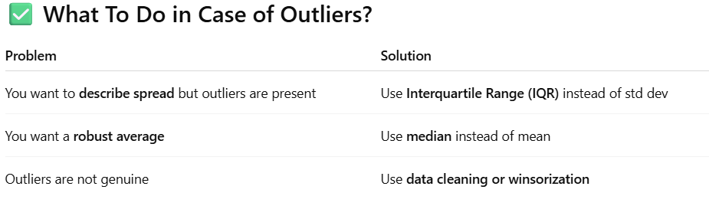

Slide 8
